Slide 1
Network Fundamentals
CIS 480 – Intro to Network Security
Computer Information Systems
University of Louisville
Ghiyoung Im, PhD

Slide 2
Objectives
Identify the basic network architectures.
Define the basic network protocols.
Explain routing and address translation.
Classify security zones.
understand principles behind network layer services
Learn about transport layer protocols in the Internet

Slide 3
Network Fundamentals Outline
1. Basic Network Concepts
Network Topologies
Network Hardware
Network Design
2. The OSI 7 Layers
3. Internet Protocol
IPv4
ARP & RARP
IPv6
DNS
4. Transport Protocol
UDP
TCP
ICMP/IGMP
5. Packet Analysis
IP
TCP

Slide 4
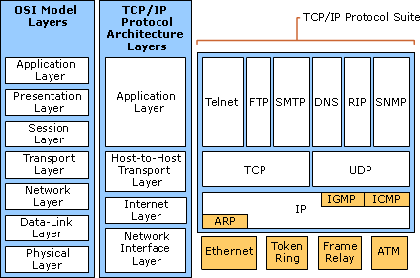
Class Overview
* technet.microsoft.com, 2003

Slide 5
Basic Terms
Octet
Byte
Host
Any device attached to the global Internet (client PCs, large servers, etc)

Slide 6
Network Architectures
Local area network (LAN)
Typically smaller in terms of size and geographic coverage, and consists of two or more connected devices. Home networks and most small office networks can be classified as LANs.
MAN (Metropolitan Area Network)
Wide area network (WAN)
Tends to be larger, covering more geographic area, and consists of two or more systems in geographically separated areas connected by any of a variety of methods.
Internet
The global network that connects millions of systems.
Personal Area Networks (PAN)
Wireless telecommunications network for device-to-device connections within a small range (e.g., Bluetooth)

Slide 7
A-1: A Simple Home Network
* Panko, 2010
Notes:
Uverse

Slide 8
A-4: Wide Area Networks (WANs)
* Panko, 2010

Slide 9
A-5: The Internet
Network
Notes:
The global Internet has thousands of networks connected by routers.

Slide 10
Network Topology
One major component of every network’s architecture is the network’s topology — how the network is physically or logically arranged
The main classes of network topologies are star, ring, bus, and mixed

Slide 11
Physical Network Topologies
Star:
Systems are connected to a central device
Bus:
Systems are connected to the same cable segment
Ring
Systems are connected to each other in a closed loop
Mixed:
Larger networks may employ multiple topologies at the same time

Slide 12
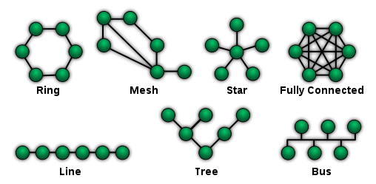
Network Topologies
* Wikipedia, 2011

Slide 13
Categories of Network Topologies
Physical Topologies | Logical Topologies
The shape of the cabling layout used to link devices | The way that the data passes through the network from one device to the next without regard to the physical interconnection of the devices
Ring, Star, Tree | Ethernet, Token Ring
Determined by the physical layout of cables, wires, and network devices | Determined by network protocols
A network's logical topology is not necessarily the same as its physical topology. | - Ethernet: Logical bus topology in a physical star topology - Token Ring: Logical ring topology in a physical star topology
* Wikipedia, 2011

Slide 14
Ethernet
The most popular media access protocol (layer 2) used on LANs
Local area network (LAN) technology developed by Xerox, Digital, Intel and commercialized in 1980 (IEEE 802.3)
Speed: 10 Mbps -> 10 Gbps
Shared media (bus topology)
Development to Switched media (star topology): data is less public

Slide 15
A-3: Building LAN
* Panko, 2010

Slide 16
Ethernet MAC
Multiple user share the same media
Media Access Control: CSMA/CD (Carrier Sense Multiple Access w/ Collision Detection)
Steps for communication:
Check whether a user is transmitting data
Wait when the data is transmitted
Monitor to check whether collusions occurred

Slide 17
Ethernet: Unreliable, connectionless
Connectionless: No handshaking between sending and receiving NICs
Unreliable: receiving NIC doesn’t send ACKs or NACKs to sending NIC
stream of datagrams passed to network layer can have gaps (missing datagrams)
gaps will be filled if app is using TCP
otherwise, app will see gaps
* Kurose, 2010

Slide 18
Ethernet Frame Structure
Preamble | Start of Frame Delimiter | MAC Destination | MAC Source | Length/Type | Data | CRC
7 Bytes of 10101010 | 1 Byte of 10101011 | 6 | 6 | 2 | 46~1500 | 4
Frame length:
Min 64 to Max 1518 Bytes (except Preamble, SFD)
Maximum Transmission Unit:
1500 Bytes (except Preamble, SFD, MAC header, CRC)

Slide 19
Ethernet Frame Structure (2)
Preamble:
7 bytes of 10101010 followed by one byte of 10101011
To synchronize receiver, sender clock rates
Addresses (6 Bytes)
Vendor Code (OUI) + Serial Number
Unique number
Length/Type:
If > 0x600 => Type (DIX 2.0): indicates higher layer protocol
If < 0x600 => Length (802.3)
CRC: for error checking

Slide 20
A-6: Frames and Packets
* Panko, 2010

Slide 21
Cabling Categories
Cat-1: Traditional phone line, voice
Cat-2: 4 Mbits/sec, voice/data
Cat-3: 10 Mb, voice/data
Ethernet 10BASE-T, 4 Mb Token-Ring
Cat-4: 16 Mb, voice/data
Not in use
Cat-5/5e: 100 Mb/1Gb, voice/data
Cat-6: Gigabit Ethernet, voice/data

Slide 22
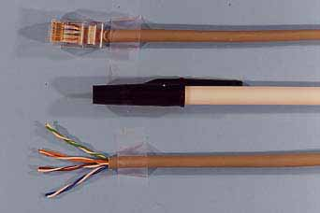
A-2: Unshielded Twisted Pair Wiring (UTP) Cord
* Panko, 2010

Slide 23
Hub
Replicates data it receives onto all ports
Employs star topology
Layer 1 device
Generally refers dummy hub
Does not have traffic monitoring capabilities
All ports connected to hub can collide with one another (no CSMA/CD)
Switching hub
Layer 2 device
Delivers packets to the appropriate port, based on the packet's address

Slide 24
Bridge
Connect two physical segments of a network
Switch: multiport bridge
Bridge: 2 port switch
Not in use => Switching Hub, LAN Switch, Brouter (Bridge + Router)

Slide 25
Switch
Layer 2 Switch
Each port has a MAC address and forward a data frame to its destined segment/system
Characteristics
Fast: uses ASIC, not CPU
Microsegmentation of a network
Multiport Bridge
Each port can have a dedicated channel and uses full-duplex
Layer 3 Switch
Make decisions based on IT address

Slide 26
Router
Layer 3 device
Connect different logical networks
Switch, Bridge: connects physical segments on the same logical network
Forward packets based on IP addresses
Drop packets if the destination is not known
Need explicit configuration that has routing paths
Drop MAC-level broadcast traffic

Slide 27
Virtual LAN (VLAN)
Segments a physical segment into different logical networks
Load balancing, reduced broadcast
Security: Systems on separate VLANs cannot directly talk to each other
Flexibility: use software for reallocation
Type:
Port-based VLAN (Layer 1)
MAC address-based VLAN (Layer 2)
IP address-based VLAN (Layer 3)
Protocol-based VLAN (Layer 1-3)

Slide 28
Network Access Control
A user’s computer cannot connect to a network until it meets defined policy standards such as malware protection level, patches, and configuration
A computer should be scanned and checked by a pre-installed software agent prior to the connection
Goals
Mitigation of zero-day attacks
Policy enforcement
Identity and access management
* Wikipedia, 2011

Slide 29
Network Design
Untrusted zone: Internet
Semi-trusted zone: Web, Mail servers
Trusted zone: DNS for inner network, Database and Application servers
Firewalls:
Between untrusted zone and semi-trusted zone
Between semi-trusted zone and trusted zone
Between entities with different trust levels

Slide 30
Demilitarized Zone (DMZ)
A computer host or small network inserted as a "neutral zone" between a company's private network and the outside public network
It prevents outside users from getting direct access to a server that has company data
In addition, endpoint security controls, s.a. firewall, antivirus and patch management, should be implemented
* searchsecurity.techtarget.com
Notes:
In computer networks, a DMZ (demilitarized zone) is a computer host or small network inserted as a "neutral zone" between a company's private network and the outside public network. It prevents outside users from getting direct access to a server that has company data. (The term comes from the geographic buffer zone that was set up between North Korea and South Korea following the UN "police action" in the early 1950s.) A DMZ is an optional and more secure approach to a firewall and effectively acts as a proxy server as well.
In a typical DMZ configuration for a small company, a separate computer (or host in network terms) receives requests from users within the private network for access to Web sites or other companies accessible on the public network. The DMZ host then initiates sessions for these requests on the public network. However, the DMZ host is not able to initiate a session back into the private network. It can only forward packets that have already been requested.
Users of the public network outside the company can access only the DMZ host. The DMZ may typically also have the company's Web pages so these could be served to the outside world. However, the DMZ provides access to no other company data. In the event that an outside user penetrated the DMZ host's security, the Web pages might be corrupted but no other company information would be exposed. Cisco, the leading maker of router s, is one company that sells products designed for setting up a DMZ.

Slide 31
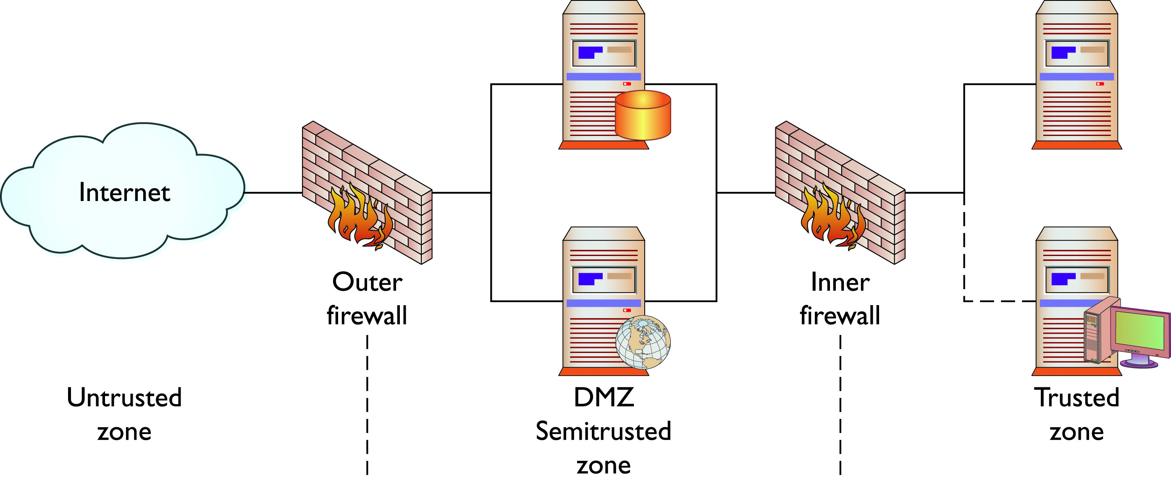
DMZ and Firewalls
* Conklin & White, 2010

Slide 32
Network Fundamentals Outline
1. Basic Network Concepts
Network Topologies
Network Hardware
Network Design
2. The OSI 7 Layers
3. Internet Protocol
IPv4
ARP & RARP
IPv6
DNS
4. Transport Protocol
UDP
TCP
ICMP/IGMP

Slide 33
Network Protocols
Rules, procedures for exchanging data among computer systems
Components of a protocol
Syntax: data format, encoding
Semantics: interpretation of patterns, error control
Synchronization: Sequence control

Slide 34
OSI reference model
Developed by Internal Standards Organization (ISO)
Deals with connecting open systems – system that are open for communication w/ other systems
Has 7 layers
Each has a different level of abstraction
Each performs a well defined function
Each layer’s function defines internally standardized protocols
The layer boundaries chosen to minimize the information flow across the interfaces
The number of layers should be large enough and small enough
* Tanenbaum, 1996

Slide 35
OSI Layers
Layer | Function | Protocols or Standards
L7: Application | Provides services s.a. email, file transfers, and file servers | HTTP, FTP, DNS, SNMP, MIME
L6: Presentation | Provides encryption, code conversion, and data formatting | MPEG, JPEG, TIFF
L5: Session | Negotiates and establishes a connection w/ another computer | SQL, X-Windows, RPC
L4: Transportation | Supports end-to-end routing across networks | TCP, UDP, SPX
L3: Network | Performs packet routing across networks | IP, ICMP, ARP
L2: Data link | Provides error checking, and transfer of message frames | Ethernet, Token Ring, 802.11
L1: Physical | Interfaces w/ transmission medium and sends data over the network | EIA RS-232, EIA RS-449, IEEE 802
* Cole, 2009

Slide 36
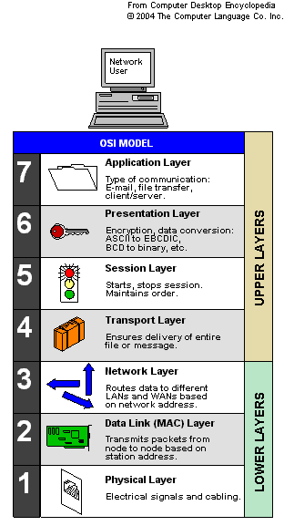
Functions of OSI Layers

Slide 37
Data Link, Physical Layer
Physical
Transmission and reception of the unstructured raw bit stream over a physical medium
Data Link
Provide connection between the physical parts (e.g., cables) w/ the above layer
Address Resolution Protocol (ARP)
Reverse Address Resolution Protocol (RARP)

Slide 38
Network Layer
Routing
Addressing
Error detection
Node traffic control
The Internet Protocol (IP)
Internet control message protocol (ICMP)

Slide 39
Transport Layer
Accept data from the session layer, break it up, pass these to the network layer, and ensure the correct delivery at the other end
Transmission Control Protocol (TCP)
User Datagram Protocol (UDP)
UDP is preferred over TCP when
Real time communication
Repetitive info: the impact of one packet lost is minimal
Excessive overhead: TCP overhead causes performance issues

Slide 40
Session Layer
Establishing the connection
Transferring data
Releasing the connection
Structured Query Language (SQL)
X-Window System
Remote Procedure Call (RPC)

Slide 41
Presentation Layer
Present information to the Application layer
Puts info in a unified format so that computers can communicate
Encryption, decryption, compression, and decompression, translate codes s.a. EBCDIC or ASCII
Motion Picture Experts Group (MPEG)
Joint Photographic Experts Group (JPEG)
Tagged Image File Format (TIFF)

Slide 42
Application Layer
The interface to the user
Identifies the desired recipient of the communication.
File Transfer Protocol (FTP)
Domain Name Service (DNS)
Simple Mail Transfer Protocol (SMTP)
Simple Network management Protocol (SMNP)
Remote login (Rlogin)
Multiple Internet Mail Extensions (MIME)

Slide 43
Layered Standards Architectures
* technet.microsoft.com, 2003

Slide 44
TCP/IP Model Layers
Layer | Function | Protocols or Standards
Application | A process above the Transport Layer Communicates via sockets and ports | SMTP, POP, HTTP, FTP
Host-to-Host or Transport Layer | Performs packet sequencing Supports reliable end-to-end communications Ensures data integrity Provides for error-free delivery | TCP, UDP
Internet Layer | Isolates the upper-layer protocols from the details of the underlying network and manages the connections across the network Uses protocols that provide for logical transmission of packets over a network and controls communication Assigns IP addresses to network nodes | IP, ICMP
Network Access Layer | Mapping IP addresses to MAC addresses and encapsulation of IP datagrams into frames to be transmitted by the network Comm. h/w and s/w, connectors, voltage levels, and cabling | ARP, RARP, EIA RS-232, EIA RS-449, IEEE 802
* Cole, 2009

Slide 45
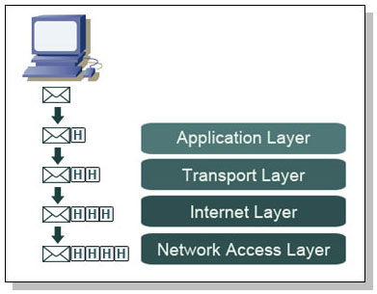
TCP/IP Encapsulation
* learn-networking.com, 2011

Slide 46

Mail Delivery Analogy

Slide 47
Network Fundamentals Outline
1. Basic Network Concepts
Network Topologies
Network Hardware
Network Design
2. The OSI 7 Layers
3. Internet Protocol
IPv4
ARP & RARP
IPv6
DNS
4. Transport Protocol
UDP
TCP
ICMP/IGMP

Slide 48
3. Internet Protocol
Delivers packet via the Internet
TCP, UDP, ICMP uses IP
Has the addressing scheme
Provides best-effort service: no error control, no flow control
Connectionless, unreliable
Relies on upper layers
IPv4 -> IPv6

Slide 49
IPv4 Packet Structure
Bit 0
Bit 31
Version
(4 bits)
Header
Length
(4 bits)
Type of Serv.
(8 bits)
Total Length
(16 bits)
Identification (16 bits)
Flags
Fragment Offset (13 bits)
Time to Live
(8 bits)
Protocol (8 bits)
1=ICMP, 6=TCP,
17=UDP
Header Checksum (16 bits)
Source IP Address (32 bits)
Destination IP Address (32 bits)
Options (if any)
Padding
Data Field

Slide 50
IP Header Key Fields
Version: IP protocol version number
Header Length: header length (in 32-bit units)
Type of Service: “type” of data
Length: total datagram length (bytes)
16-bit identifier, Flags, Fragment Offset: For fragmentation/reassembly
Time to live: max number remaining hops (decremented at each router)
Protocol: upper layer protocol to deliver payload to
Optional: E.g. timestamp, record route taken, specify list of routers to visit.

Slide 51
IP Packets Encapsulation into Ethernet Frames
Min IP packet length:
Max IP packet length:
Max MTU of Ethernet:
How many frames are necessary to carry one maximum-sized IP packet?

Slide 52
IPv4 Addresses
An address consists of the network portion of the address (net-id) and the host portion (host-id)
Displayed as 4 numbers separated by periods
Some addresses are reserved
The first address in a network (all 0s address of the host portion): the network address
The last address in a network (all 1s address of the host portion ): the broadcast address
Directed broadcast: passed by routers

Slide 53
Subnetting
Consider 10.10.10.101
IP Address: 10.10.10.101
Subnet Mask: 255.255.255.0
Net-id? Host-id?
How to get the network address?
CIDR (Classless Inter-Domain Routing)
Uses variable length subnet masks to allocate IP addresses to subnets
10.10.10.101/16
=> uses 16 bits for net-id

Slide 54
IPv4 Address Classes
Class A
The first bit = 0 (=> 1-127)
N.H.H.H
255.0.0.0 (/8)
Class B
The first two bits = 10 (128–191)
N.N.H.H
255.255.0.0 (/16)
Class C
The first three bits = 110 (192-223)
N.N.N.H
255.255.255.0 (/24)
* Conklin & White, 2010
Notes:
Network address spaces are usually divided into one of three classes:
■ Class A Supports 16,777,214 hosts on each network with a default subnet mask of 255.0.0.0
Subnets: 0.0.0.0 to 126.255.255.255 (127.0.0.0 to 127.255.255.255 is reserved for loopback)
-> large network
■ Class B Supports 65,534 hosts on each network with a default subnet mask of 255.255.0.0
Subnets: 128.0.0.0 to 191.255.255.255
-> medium network
■ Class C Supports 253 hosts on each network with a default subnet mask of 255.255.255.0
Subnets: 192.0.0.0 to 223.255.255.255
Everything above 224.0.0.0 is reserved for either multicasting or future use.
In addition, certain subnets are reserved for private use and are not routed across public networks such as the Internet:
■ 10.0.0.0 to 10.255.255.255
■ 172.16.0.0 to 172.31.255.255
■ 192.168.0.0 to 192.168.255.255

Slide 55
Private Address
Private address
10.0.0.0 – 10.255.255.255
172.16.0.0 – 172.31.255.255
192.168.0.0 – 192.168.255.255
They are not routed
Compensate for the shortage of public IP addresses
Use Network Address Translation (NAT) to map private (nonroutable) IP addresses into public (routable) IP addresses

Slide 56
NAT vs DHCP
Network Address Translation (NAT)
Dynamic Host Configuration Protocol (DHCP)
How do your home network connect to the Internet?
Uses the access router. It’s a switch and has a wireless access point.
First, obtain an IP address from the access router’s DHCP server
Next, the access router provides NAT, which hides internal IP addresses

Slide 57
MAC Address & IP Address
MAC address (Layer2 - Data Link layer)
48-bit (6 byte) address, burned into the ROM of the NIC (Network Interface Card)
Also called the Hardware address, or Ethernet address
Expressed as six pairs of hexadecimal digits
IP address (Layer 3 - Network layer)
32-bit (4 byte) software stored address
Assigned to represent the same NIC as MAC address represents
Like a shorter nickname for the 48-bit MAC address
* Source: infocellar.com

Slide 58
Packet Delivery
Packets delivered on a network (e.g., LAN)
Use the Media Access Control (MAC) address
Address Resolution Protocol (ARP): IP address -> MAC address
Packet delivery to a remote system
Use the Internet Protocol (IP) address
Use the Domain Name System (DNS) protocol to convert IP addresses to hostnames
* Conklin & White, 2010

Slide 59
ARP & RARP
Address Resolution Protocol (ARP)
Address resolution protocol that converts logical IP address to physical MAC address (layer 2 protocol)
Router sends a broadcast to the network: “Who has 10.10.10.101? Tell 10.10.10.102”. The host 10.10.10.101 should reply with its MAC address.
ARP cache: the new entry is placed in the cache
Reverse Address Resolution Protocol (RARP)
Obtain IP address from MAC address
Not in use -> instead use DHCP (Dynamic Host Configuration Protocol)

Slide 60
Limitations of IPv4
The recent exponential growth of the Internet and the impending exhaustion of the IPv4 address space
The growth of the Internet and the ability of Internet backbone routers to maintain large routing tables
The need for simpler configuration
The requirement for security at the IP level
The need for better support for real-time delivery of data—also called quality of service (QoS)
* technet.microsoft.com, 2011

Slide 61
IPv6 Features
New header format
Large address space
Efficient and hierarchical addressing and routing infrastructure
Stateless and stateful address configuration
Built-in security
Better support for prioritized delivery
New protocol for neighboring node interaction
Extensibility
* technet.microsoft.com, 2011

Slide 62
Differences Between IPv4 and IPv6
IPv4 | IPv6
Addresses are 32 bits (4 bytes) in length. | Addresses are 128 bits (16 bytes) in length
IPsec support is optional | IPsec support is required
No QoS handling by routers | Quality of Service (QoS) included in the header
Header includes a checksum | Header does not include a checksum
Header includes options | All optional data is moved to IPv6 extension headers
ARP uses broadcast ARP Request frames to resolve an IPv4 address to a link layer address | ARP Request frames are replaced with multicast Neighbor Solicitation messages
* technet.microsoft.com, 2011

Slide 63
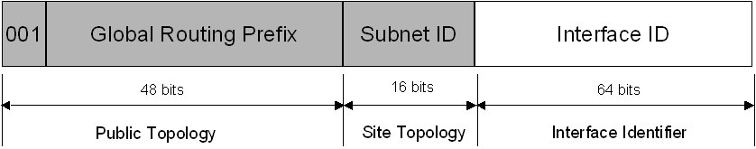
IPv6 Address
IPv4: supports 2³² (4,294,967,296)
IPv6: supports 2¹²⁸ (340 undecillion) addresses (7 addresses per person)
Example:
2001:0DB8:0000:2F3B:02AA:00FF:FE28:9C5A
Global Unicast Addresses
* technet.microsoft.com, 2011

Slide 64
Structure of an IPv6 Packet
Priority: identify priority among datagrams in flow
Flow Label: Used for QoS functionality
Next Header: identify upper layer protocol for data

Slide 65
Domain Name System
Translates names into IP addresses
The initial solution for name resolution
Use Hosts.txt used on ARPANET
Computers on the ARPANET periodically downloaded Hosts.txt from a central location
Domain Name System
Defines a namespace and a protocol for name resolution and database replication
Has a hierarchical and logical tree structure
DNS queries sent over UDP first. The hosts (DNS clients) resort to TCP only if the returned data is truncated
* technet.microsoft.com, 2011

Slide 66
DNS Server

Slide 67
DNS Domain Names
Types of DNS Domain Names
Root domain: “” or . (period)
Top level domain: “com”
Second level domain: “microsoft.com”
Subdomain: “mydomain.microsoft.com”
Host or resource name: “host-a. mydomain.microsoft.com”
Generic top-level domains (as of Sep, 2011)
aero, asia, biz, cat, com, coop, edu, gov, info, int, jobs, mil, mobi, museum, name, net, org, pro, tel, travel, xxx (total 21)
Country code top-level domains
ac, ad, ae, af, ag, ai, al, am, an, etc
* technet.microsoft.com, 2011

Slide 68
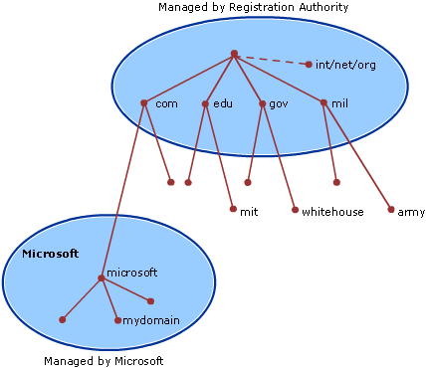
DNS Hierarchy
* technet.microsoft.com, 2011
Notes:
Hierarchy-based scheme.

Slide 69
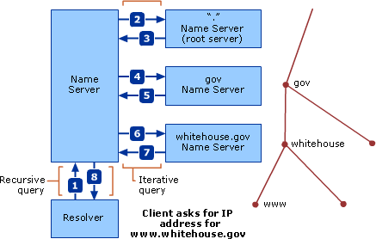
DNS Query
* technet.microsoft.com, 2011

Slide 70
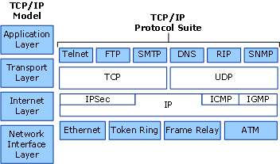
DNS in TCP/IP
* technet.microsoft.com, 2011

Slide 71
DNS Security Threats
Threats
Footprinting: DNS zone data is obtained by an attacker (info leakage)
Denial-of-service attack
Data modification (IP spoofing): use valid IP addresses in IP packets the attacker has created
Redirection (cache poisoning)
Defenses
Limit zone transfers to specified IP addresses
Enable secure cache against pollution
Place DNS server on a perimeter network
Add a secondary server on another subnet or network
* technet.microsoft.com, 2011

Slide 72
Network Fundamentals Outline
1. Basic Network Concepts
Network Topologies
Network Hardware
Network Design
2. The OSI 7 Layers
3. Internet Protocol
IPv4
ARP & RARP
IPv6
DNS
4. Transport Protocol
UDP
TCP
ICMP/IGMP

Slide 73
User Datagram Protocol (UDP)
Connectionless service; no session is established between hosts
UDP does not guarantee or acknowledge delivery, or sequence data
Programs that use UDP are responsible for providing any reliability needed to transport data
UDP is fast, has low overhead requirements, and can support point-to-point and point-to-multipoint communication
* technet.microsoft.com, 2011

Slide 74
Values of UDP
Voice and video traffic - real-time video and audio streaming protocols
Multicasting
DNS queries
A single UDP request from the client
A single UDP reply from the server
UDP ports
A location for sending and receiving UDP messages.
UDP port numbers: 53 (DNS), 67 and 68 (Bootp), 69 (TFTP), 161 (SNMP), 2049 (NFS)

Slide 75
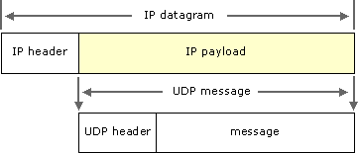
UDP Header
0 – 15 | 16 – 31
SRC Port Number | DST Port Number
Length | Checksum
Data (Variable)
* technet.microsoft.com, 2011
Notes:
Header is very simple. 8 bytes.

Slide 76
Transmission Control Protocol (TCP)
Connection-oriented service; a session is established between hosts
TCP guarantees delivery through the use of acknowledgments and sequenced delivery of data
Programs that use TCP are provided assurance of reliable data transport
TCP is slower, has higher overhead requirements, and only supports point-to-point communication
TCP Ports
20 (FTP-data), 21 (FTP-control), 23 (Telnet), DNS (53), 80 (HTTP), 110 (POP), HTTPS (443)
* technet.microsoft.com, 2011

Slide 77
TCP Segment
Source Port Number (16 bits)
Destination Port Number (16 bits)
Sequence Number (32 bits)
Acknowledgment Number (32 bits)
Header
Length
(4 bits)
Reserved
(6 bits)
Flag Fields
(6 bits)
Window Size
(16 bits)
TCP Checksum (16 bits)
Urgent Pointer (16 bits)

Slide 78
TCP Fields
Sequence number, Acknowledgement number: counting by bytes of data (not segments!)
Flag fields:
U: URG: urgent data (generally not used)
A: ACK: ACK # valid
P: PSH: push data now (generally not used)
R, S, F: RST, SYN, FIN: connection estab (setup, teardown commands)
Window size: # of bytes a sender can transmit without receiving an ack.
Checksum: Internet checksum (as in UDP)

Slide 79
Three Way Handshake
Step 1 (client): sends SYN segment to the server
The segment has initial client seq #
Step 2 (server): receives SYN, replies with SYN/ACK segment
The server allocates buffers
The server segment has initial server seq. #
Step 3 (client): receives SYN/ACK and replies with ACK segment

Slide 80
Closing a Connection
Graceful closure
Step 1 (client): sends FIN segment to server
Step 2 (server): receives FIN and replies with ACK. Closes connection and sends FIN
Step 3 (client): receives FIN and replies with ACK
Step 4 (server): receives ACK. Connection closed
Abrupt closure
Send RST from either side

Slide 81
Messages in a TCP Session (1)
PC
Transport Process
Webserver
Transport Process
1. SYN (Open)
Open
(3)
2. SYN, ACK (1) (Acknowledgement of 1)
3. ACK (2)
3-Way Open

Slide 82
Messages in a TCP Session (2)
PC
Transport Process
Webserver
Transport Process
1. SYN (Open)
Open
(3)
2. SYN, ACK (1) (Acknowledgement of 1)
3. ACK (2)
4. Data = HTTP Request
Carry
HTTP
Req &
Resp
(4)
5. ACK (4)
6. Data = HTTP Response
7. ACK (6)

Slide 83
Messages in a TCP Session (3)
PC
Transport Process
Webserver
Transport Process
8. Data = HTTP Request (Error)
Carry
HTTP
Req &
Resp
(4)
9. Data = HTTP Request (No ACK so Retransmit)
10. ACK (9)
11. Data = HTTP Response
12. ACK (11)
Error Handling

Slide 84
Messages in a TCP Session (4)
PC
Transport Process
Webserver
Transport Process
Normal Four-Way Close
13. FIN (Close)
Close
(4)
14. ACK (13)
15. FIN
16. ACK (15)
Note: An ACK may be combined with the next message if the next message
is sent quickly enough

Slide 85
Messages in a TCP Session (5)
PC
Transport Process
Webserver
Transport Process
Abrupt Close
RST
Close
(1)
Either side can send
A Reset (RST) Segment
At Any Time
Ends the Session Immediately

Slide 86
Internet Control Message Protocol (ICMP)
A control and information protocol and is used by network devices
Determine a remote network’s availability, the length of time to reach a remote network, and the best route for packets to take
Provides troubleshooting facilities and error reporting for packets that are undeliverable
Probably the third most commonly used protocol
Network-layer “above” IP
ICMP messages delivered in the data fields of IP packets
* technet.microsoft.com, 2003

Slide 87
Internet Control Message Protocol (ICMP)

Slide 88
Common ICMP Messages
ICMP Message | Function
Echo Request | Troubleshooting message used to check IP connectivity to a desired host. The ping utility sends ICMP Echo Request messages
Echo Reply | Response to an ICMP Echo Request
Redirect | Sent by a router to inform a sending host of a better route to a destination IP address
Source Quench (elective message) | Sent by a router to inform a sending host that its IP datagrams are being dropped due to congestion at the router. The sending host then lowers its transmission rate.
Destination Unreachable | Sent by a router or the destination host to inform the sending host that the datagram cannot be delivered
* technet.microsoft.com, 2003

Slide 89
Internet Group Management Protocol (IGMP)
Manages host membership in IP multicast groups (host groups) on a network segment
An IP multicast group is a set of hosts that listen for IP traffic destined for a specific IP multicast address
IP multicasting
Host group membership is dynamic, hosts can join and leave the group at any time
A host group can be of any size
Members of a host group can span IP routers across multiple networks
A host can send traffic to an IP multicast address without belonging to the corresponding host group

Slide 90
Utilities
cmd
Microsoft-supplied command-line interpreter
ipconfig
Displays all current TCP/IP network configuration values
traceroute
Determines the route to a destination
Windows “tracert” uses ICMP) echo packets to the destination
UNIX “traceroute” uses UDP packets
netstat
Viewing ports

Slide 91
Packet Analysis
Uses hexadecimal numbers
Base is 16
Notation: “0x”
11111111 (binary) => 255 (decimal)
Hex: ???
Offsets start at 0
8 bits (a byte) = two hex characters

Slide 92
Hexadecimal Numbers
2³ | 2² | 2¹ | 2⁰ | Hex
0 | 0 | 0 | 0 | 0
0 | 0 | 0 | 1 | 1
0 | 0 | 1 | 0 | 2
0 | 0 | 1 | 1 | 3
0 | 1 | 0 | 0 | 4
0 | 1 | 0 | 1 | 5
0 | 1 | 1 | 0 | 6
0 | 1 | 1 | 1 | 7
2³ | 2² | 2¹ | 2⁰ | Hex
1 | 0 | 0 | 0 | 8
1 | 0 | 0 | 1 | 9
1 | 0 | 1 | 0 | a (10)
1 | 0 | 1 | 1 | b (11)
1 | 1 | 0 | 0 | c (12)
1 | 1 | 0 | 1 | d (13)
1 | 1 | 1 | 0 | e (14)
1 | 1 | 1 | 1 | f (15)

Slide 93
A Sample Frame: 66 bytes (528 bits)
Ethernet II (DEX Ethernet): 14 bytes
Internet Protocol Version 4: 20 bytes
Transmission Control Protocol: 32 bytes
00 22 5f 58 2b 0d 00 13 46 cc a3 ea 08 00 45 20
00 34 d5 6e 00 00 37 06 8f 34 4a 7d 13 69 c0 a8
00 73 00 50 60 9a 0e 02 d5 0d 7a d1 01 0c 80 12
16 58 79 ef 00 00 02 04 05 96 01 01 04 02 01 03
03 06

Slide 94
IP Header (1)
(1)
(2)
(3)
(4)
(1) Version: 4
(2) IHL: 5
(3) Type of Service
(ToS): Priority
0010 00..
.... ..00
(4) Total length:
0x34 (52)
45 20 00 34
d5 6e 00 00
37 06 8f 34
4a 7d 13 69
c0 a8 00 73
Notes:
* Type of Service: http://www.freesoft.org/CIE/Course/Section3/7.htm

Slide 95
IP Header (2)
(5) IP Identification:
0xd56e (54638)
(6,7) Flags, Fragment offset:
0x0000 = 0000 0000 0000 0000
45 20 00 34
d5 6e 00 00
37 06 8f 34
4a 7d 13 69
c0 a8 00 73
(5)
(6,7)
Notes:
* Type of Service: http://www.freesoft.org/CIE/Course/Section3/7.htm

Slide 96
IP Header (3)
(8) Time to live: 55
(9) Protocol: TCP (6)
(10) Header
checksum: 0x8f34
(11) Source:
74.125.19.105
(12) Destination:
192.168.0.115
45 20 00 34
d5 6e 00 00
37 06 8f 34
4a 7d 13 69
c0 a8 00 73
(8)
(9)
(10)
(11)
(12)
Notes:
* Type of Service: http://www.freesoft.org/CIE/Course/Section3/7.htm

Slide 97
TCP Header (1)
(1)
(2)
00 50 60 9a
0e 02 d5 0d
7a d1 01 0c
80 12 16 58
79 ef 00 00
02 04 05 96
01 01 04 02
01 03 03 06
(1) Source port:
http (80)
(2) Destination port:
24730
(3) Sequence number:
235066637
(4) Acknowledgement
number:
2060517644
(3)
(4)

Slide 98
TCP Header (2)
00 50 60 9a
0e 02 d5 0d
7a d1 01 0c
80 12 16 58
79 ef 00 00
02 04 05 96
01 01 04 02
01 03 03 06
(5) Header length,
Reserved, Flags:
1000 0000 0001 0010
(8=>32, SYN, ACK)
(6) Window size value:
5720
(7) Checksum: 0x79ef
(8) Urgent pointer: 0
(not set)
(5)
(6)
(7)
(8)

Slide 99
TCP Header (3)
00 50 60 9a
0e 02 d5 0d
7a d1 01 0c
80 12 16 58
79 ef 00 00
02 04 05 96
01 01 04 02
01 03 03 06
(9) Options (12 bytes)
Maximum segment size
(0x0204): 1430 bytes
(0x0596)
(10) Others
(9)
(10)

Slide 100
Options and Payload Length
Length of packet payload (data) = IP total length – (IP header length + TCP header length)
TCP Options length = TCP header length – Minimum TCP header length (20 bytes)

Slide 101
References
IP header format
http://www.freesoft.org/CIE/Course/Section3/7.htm
TCP header format
http://www.freesoft.org/CIE/Course/Section4/8.htm

Slide 102
Access to google.com (1)
Steps
1. ARP
A host (192.168.0.115) looking for the MAC address of the default gateway
Who has 192.168.0.1? Tell 192.168.0.115
The machine 192.168.0.1 replies back to 192.168.0.115 with its MAC address
2. DNS
The machine 192.168.0.115 sends a DNS query over UDP to 192.168.0.1 to get the IP addresses of google.com
The machine 192.168.0.1 replies back to 192.168.0.115 with the six IP addresses of google.com

Slide 103
Access to google.com (2)
Steps
3. TCP
3-way handshake begins between the 192.168.0.115 and a google.com server (74.125.19.105)
Client->Google
[SYN] Seq=2060517643 (c) Win=8192 Len=0 MSS=1460 WS=4 SACK_PERM=1
Google->Client
[SYN, ACK] Seq=235066637 (s) Ack=2060517644 (c) Win=5720 Len=0 MSS=1430 SACK_PERM=1 WS=64
Client->Google:
[ACK] Seq=2060517644 (c) Ack=235066638 (s) Win=17160 Len=0
4. HTTP
GET / HTTP/1.1
etc

